Slide 1
MAREESWARAN M
Final Project
3/21/2024 Annual Review

Slide 2
PROJECT TITLE
Poetry Generator Using RNN
3/21/2024 Annual Review

Slide 3
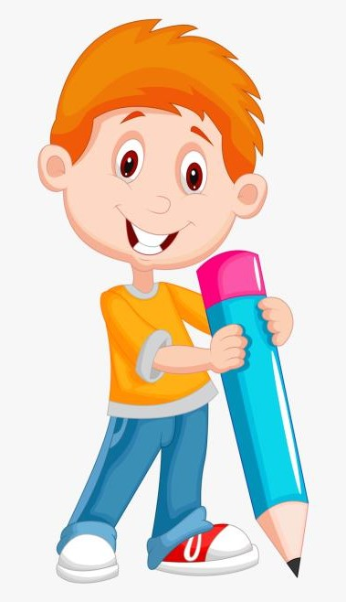

AGENDA
Problem statement
Objective
Project overview
Who is the end user
Model used
Dataset
Result
Conclusion
3/21/2024 Annual Review

Slide 4

PROBLEM STATEMENT
Developing a poetry generator involves creating an AI model capable of producing coherent and expressive poems. This requires collecting and preprocessing a dataset of poetry, designing and training an RNN-based architecture, evaluating the model's performance, and refining it for deployment. Success is measured by the quality and creativity of the generated poems.
3/21/2024 Annual Review

Slide 5
PROJECT OVERVIEW
Data Acquisition and Preprocessing:
Collect a diverse dataset of poetry spanning different styles, themes, and authors.
Preprocess the dataset by tokenizing, cleaning, and formatting the text for model training.
Model Architecture Selection:
Choose an appropriate neural network architecture for sequence generation tasks, such as Recurrent Neural Networks (RNNs) or Transformer models.
Training Process:
Train the selected model architecture on the preprocessed poetry dataset.
Utilize techniques like teacher forcing, gradient clipping, and learning rate scheduling to stabilize training and improve convergence.
3/21/2024 Annual Review

Slide 6
PROJECT OVERVIEW
Evaluation Metrics:
Evaluate the generated poems using metrics like coherence, creativity, and adherence to poetic conventions.
Consider human judgment through subjective evaluation by experts or crowdsourcing.
Fine-Tuning and Refinement:
Fine-tune the model based on evaluation feedback to improve the quality of generated poems.
Experiment with hyperparameter tuning, architectural modifications, and training strategies.
User Interface and Deployment:
Develop a user-friendly interface for users to interact with the poetry generator.
Deploy the trained model as a web application or API, allowing users to input preferences and receive generated poems.
3/21/2024 Annual Review

Slide 7

WHO ARE THE END USERS?
Poetry Enthusiasts: Individuals who have a passion for poetry and enjoy reading and exploring different styles, themes, and forms of poetry. They may use the generator to discover new poems or seek inspiration for their own writing.
Writers and Poets: Authors and poets looking for creative prompts or seeking to explore new styles and techniques. They could use the generator as a tool for brainstorming ideas or overcoming writer's block.
Educators and Students: Teachers and students in literature and creative writing classes who could use the generator for educational purposes, such as studying poetic forms, analyzing style, or generating examples for discussion.
3/21/2024 Annual Review

Slide 8
MODELLING
Recurrent Neural Networks (RNNs):
RNNs are a type of neural network architecture well-suited for sequence modeling tasks like text generation.
Variants of RNNs such as Long Short-Term Memory (LSTM) and Gated Recurrent Unit (GRU) are often used due to their ability to capture long-range dependencies in sequential data.
RNNs can generate poems word by word, with each word's probability distribution conditioned on the preceding words.
3/21/2024 Annual Review
8

Slide 9
DATASET
Data Collection: Gather a dataset of Notorious B.I.G.'s lyrics. You may find these lyrics available on various lyric websites, music databases, or through API access to lyric databases.
Data Preprocessing: Preprocess the lyrics dataset to clean the text, remove any irrelevant information (such as metadata or song titles), and tokenize the text into words or characters. You may also want to convert the text to lowercase for consistency.
Model Training: Choose a suitable model architecture (such as an RNN or Transformer) and train it on the preprocessed lyrics dataset. During training, the model learns the patterns and structure of the lyrics to generate new text.
Poetry Generation: Use the trained model to generate new poetry in the style of Notorious B.I.G.'s lyrics. You can provide a starting seed or prompt to the model and let it generate the subsequent lines of poetry.
3/21/2024 Annual Review
9

Slide 10
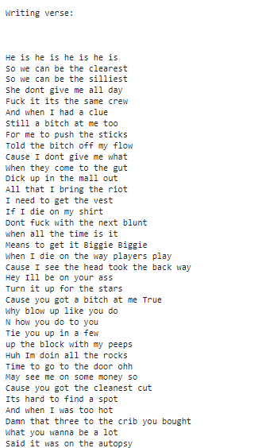
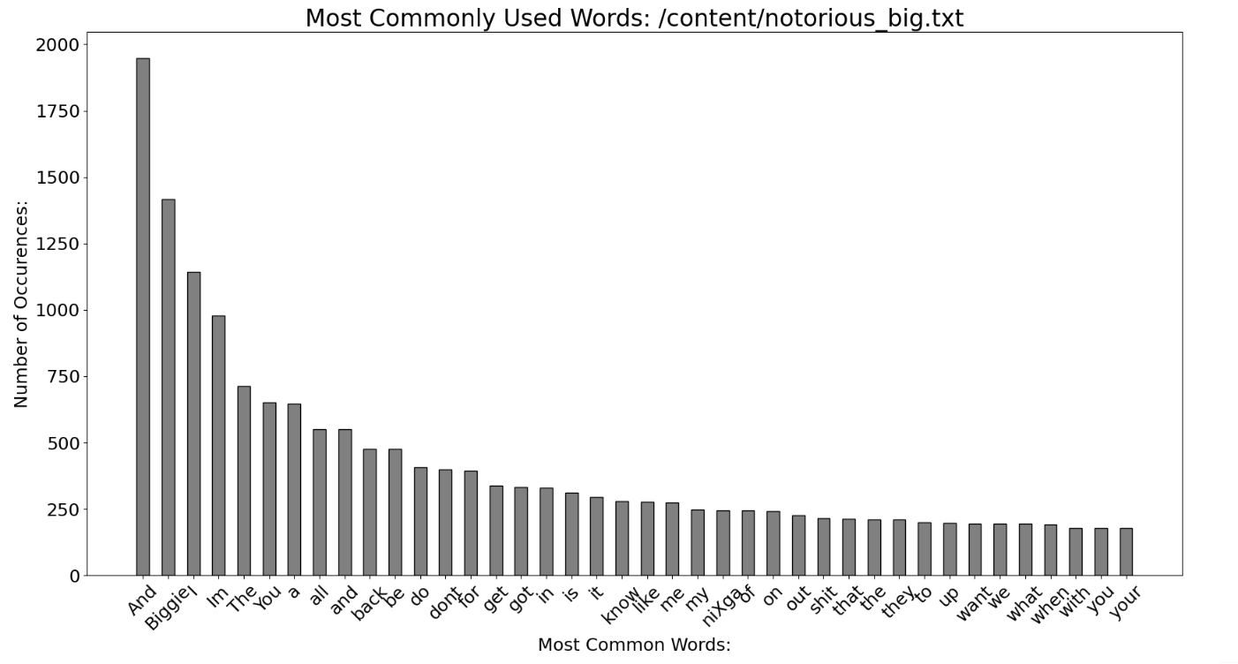
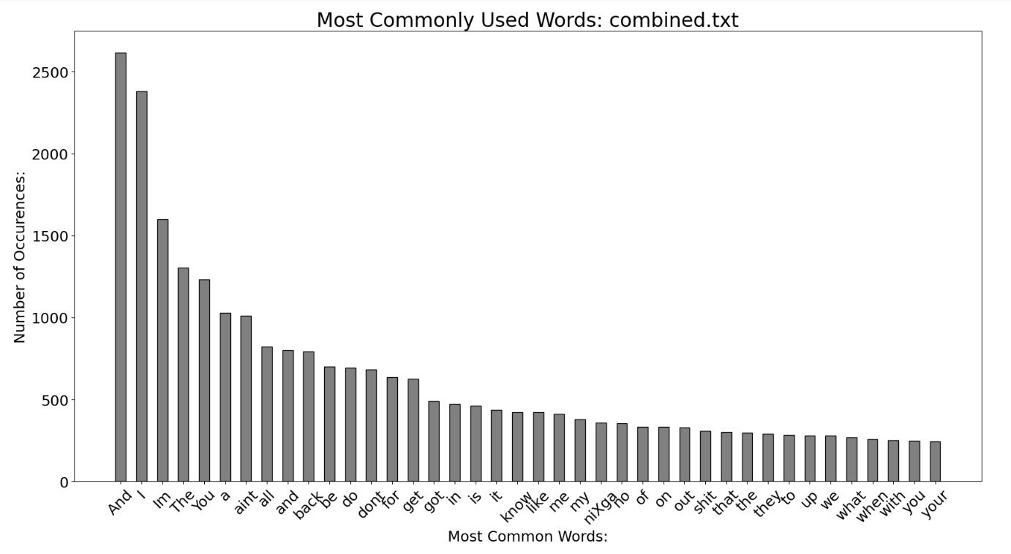
RESULTS
3/21/2024 Annual Review
10

Slide 11
conclusion
The AI-powered poetry generator project utilizing Notorious B.I.G.'s lyrics offers a novel intersection of hip-hop culture and artificial intelligence. Through data-driven exploration, it celebrates the lyrical legacy of the iconic rapper while showcasing the potential of AI to engage and inspire creativity in diverse artistic domains.
3/21/2024 Annual Review
11

